Slide 1
Computer Networks
Khizar Mukhtiar
Department of Computer Science
National University of Computer & Emerging Sciences

Slide 2
Lecture 2
Computer Network
A set of computers, servers or other communicable devices connected together

Slide 3
Recap
Data communication
Communication model
Networks criteria
Communication tasks

Slide 4
Computer Network
A computer network is like a digital community where computing devices are connected (through wire or wirelessly), allowing them to communicate and share information.
In simpler terms, a computer network lets devices talk to each other, share resources, and collaborate, making it possible for us to share files, and do various online activities.
A node can be a computer, printer, or any other device capable of sending and/or receiving data generated by other nodes on the network.

Slide 5
Building Blocks
Nodes: PC, special-purpose hardware…
  hosts
  switches
Links: coax cable, optical fiber…
  point-to-point
  multiple access
…

Slide 6
Connecting Each Node with Every Other Node
Number of computers that can be connected becomes very limited
Number of wires coming out of each node becomes unmanageable
Number of physical hardware/devices required becomes very expensive
Solution: indirect connectivity using intermediate data forwarding nodes

Slide 7
Network
A network can be defined recursively as
  two or more nodes connected by a physical link
Or
  two or more networks connected by one or more nodes

Slide 8
Connectivity
Hosts are directly or indirectly connected to each other
  Can we now provide host-host connectivity ?
Nodes must be able to say which host it wants to communicate with.

Slide 9
Switched Networks
A network can be defined recursively as...
  two or more nodes connected by a link
  white nodes (switches) implement the network
  colored nodes (hosts) use the network

Slide 10
Switched Networks
A network can be defined recursively as...
  two or more networks connected by one or more nodes: internetworks
  white nodes (router or gateway) interconnects the networks
  a cloud denotes “any type of independent network”

Slide 11
Switching Strategies
Circuit switching carry bit streams
  establishes a dedicated circuit
  links reserved for use by communication channel
  send/receive bit stream at constant rate
  example: original telephone network
Packet switching store-and-forward messages
  operates on discrete blocks of data
  utilizes resources according to traffic demand
  send/receive messages at variable rate
  example: Internet

Slide 12
Network Topologies
Topology defines the way hosts are connected to the network
Issues
  A goal of any topology
    high throughput (bandwidth)
    low latency

Slide 13
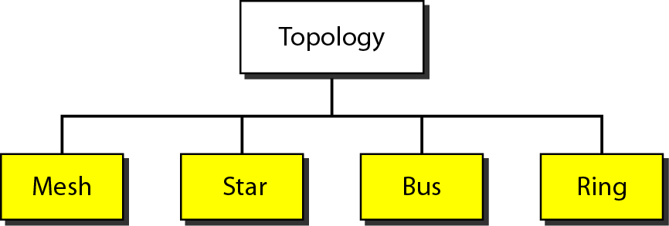
Categories of Topology

Slide 14
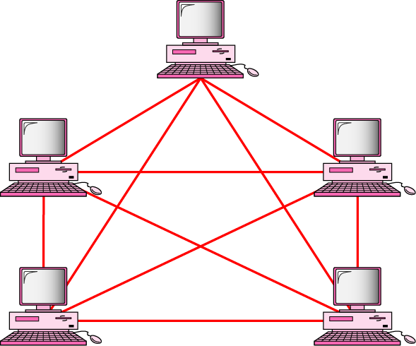
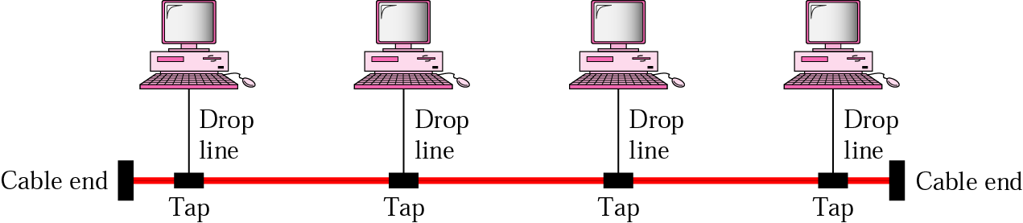
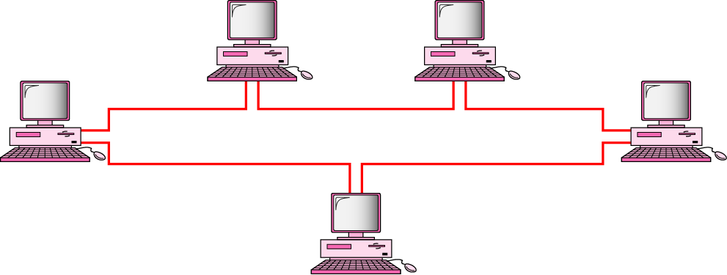
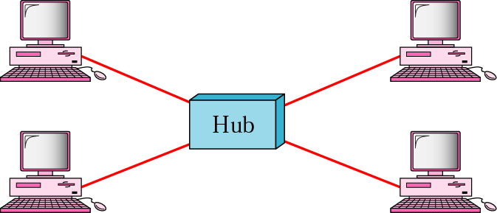
Mostly Used Network Topologies
bus
mesh
star
ring

Slide 15
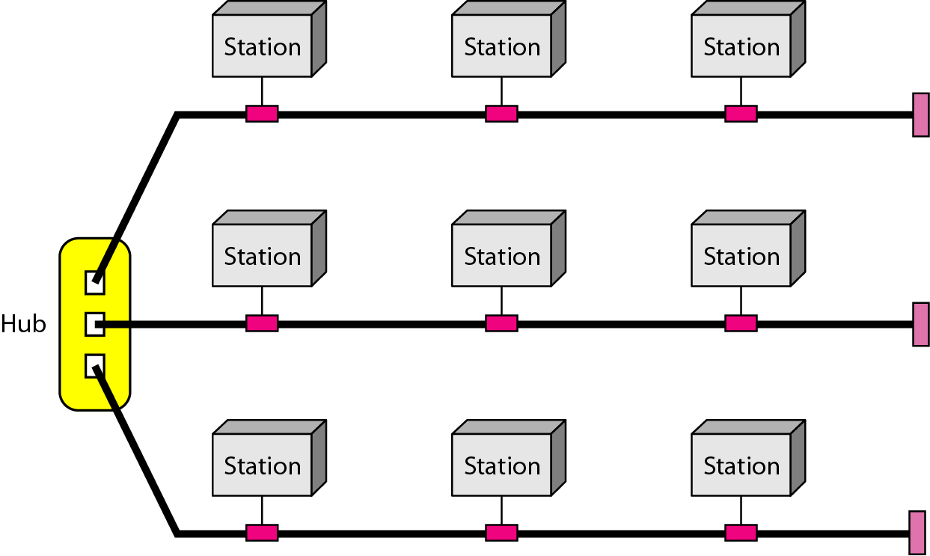
Hybrid Topology
A star backbone with three bus networks

Slide 16
Addressing and Routing
Address: byte-string that identifies a node
  usually unique
Routing: forwarding decisions
  process of determining how to forward messages to the destination node based on its address
Types of Addresses
  unicast: node-specific
  broadcast: all nodes on the network
  multicast: some subset of nodes on the network

Slide 17
Addressing and Routing
A network can be constructed from nesting of networks
An address is required for each node that is reachable on the network
Address is used to route messages toward appropriate destination

Slide 18
Addressing and Routing
Hosts know how to reach other hosts on the network
How should a node use the network for its communication ?
All pairs of hosts should have the ability to exchange messages: cost-effective resource sharing for efficiency

Slide 19
What Goes Wrong in the Network?
Reliability at stake
Bit-level errors (electrical interference)
Packet-level errors (congestion)
  distinction between lost and late packet
Link and node failures
  distinction between broken and flaky link
  distinction between failed and slow node

Slide 20
What Goes Undesirable in the Network?
Required performance at stake
Messages are delayed
Messages are delivered out-of-order
Third parties eavesdrop
The challenge is to fill the gap between application expectations and hardware capabilities

Slide 21
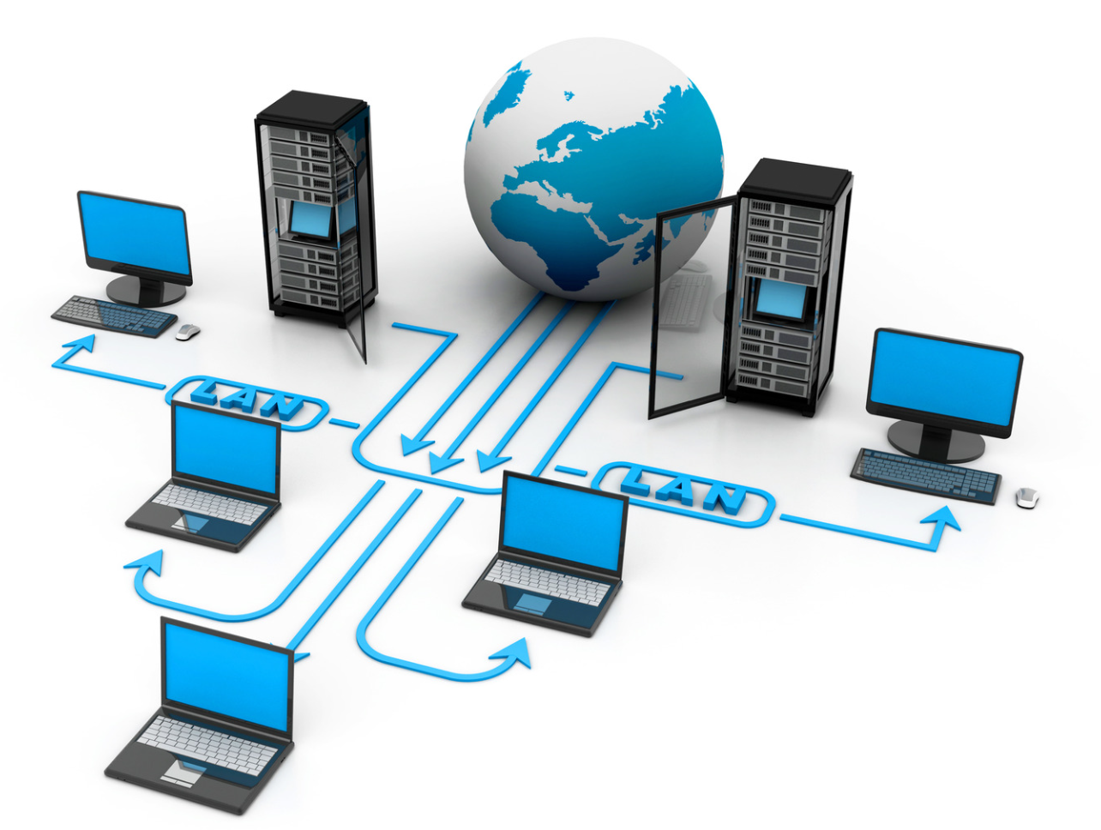
Types of Computer Networks
Notes:
A network is a set of devices (often referred to as nodes) connected by communication links. A node can be a computer, printer, or any other device capable of sending and/or receiving data generated by other nodes on the network.

Slide 22
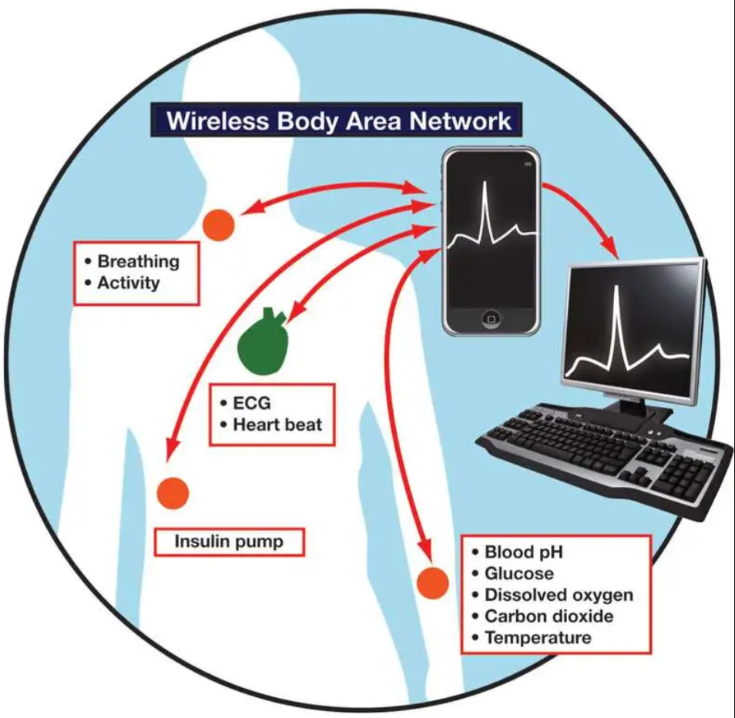
Body Area Network
A type of network that involves the connection of devices worn on or implanted within the human body.
BANs typically involve the use of wearable devices, such as smartwatches, fitness trackers, or medical sensors, which are attached to or integrated into clothing, accessories, or directly onto the body.
Range about 1 meter
Bluetooth, infrared
Data rate Less than 1mbps

Slide 23
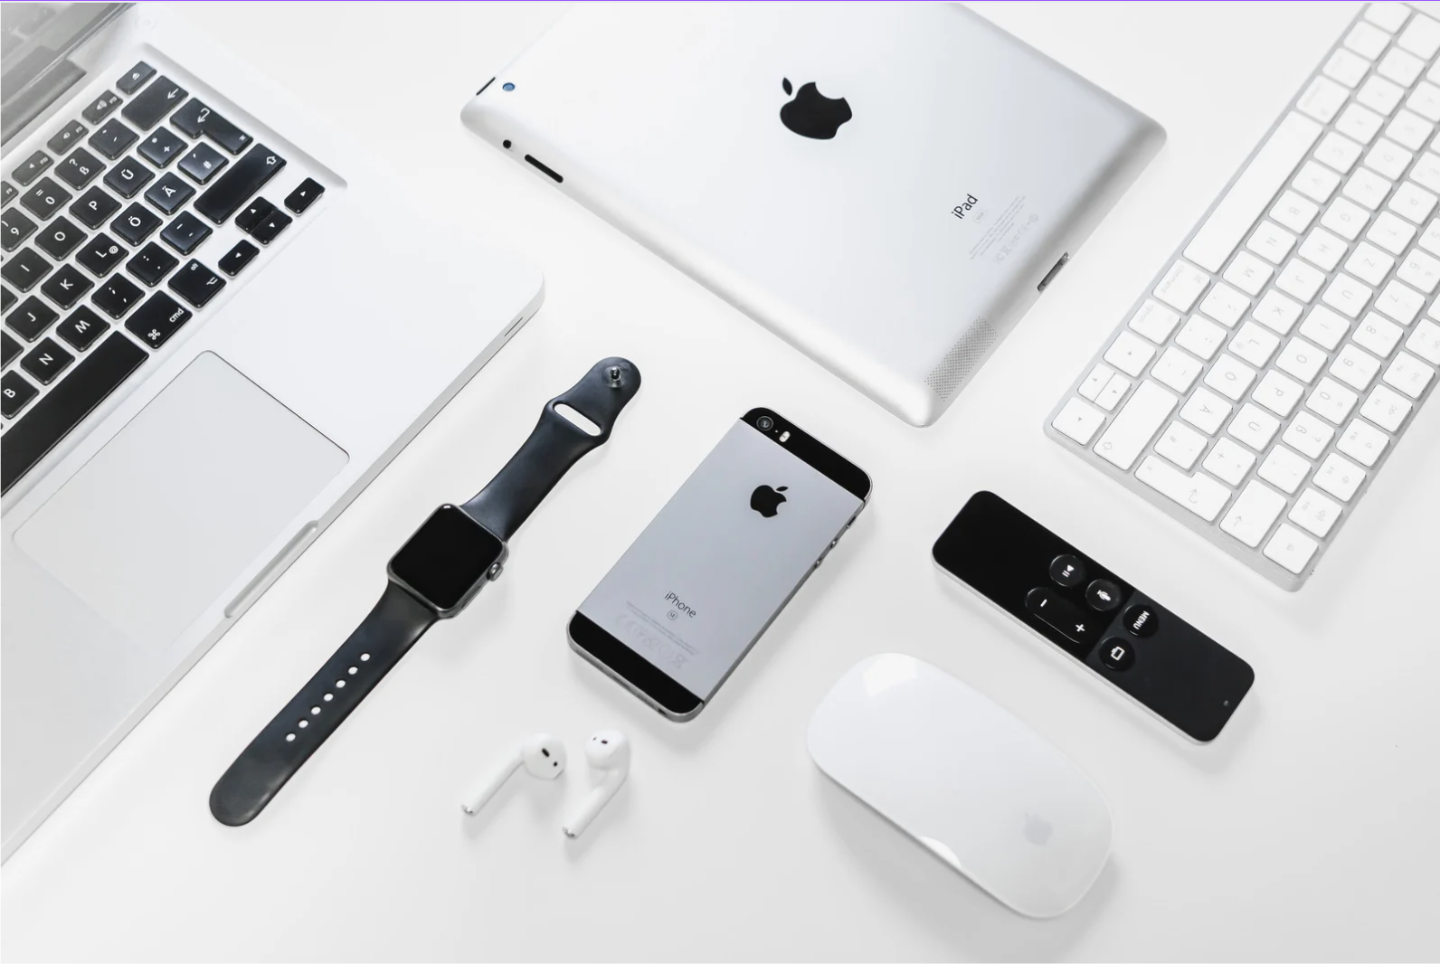
PAN
A Personal Area Network (PAN) focus on facilitating communication among devices within the immediate vicinity of an individual.
PANs are designed for personal use and are often centered around an individual's electronic devices such as computers, printer, camera, and tablets etc.
Restricted to personal area
  Office desk, bed, room etc
Range about 5 meter
Bluetooth, NFC, infrared
Data rate Less than 2 mbps

Slide 24
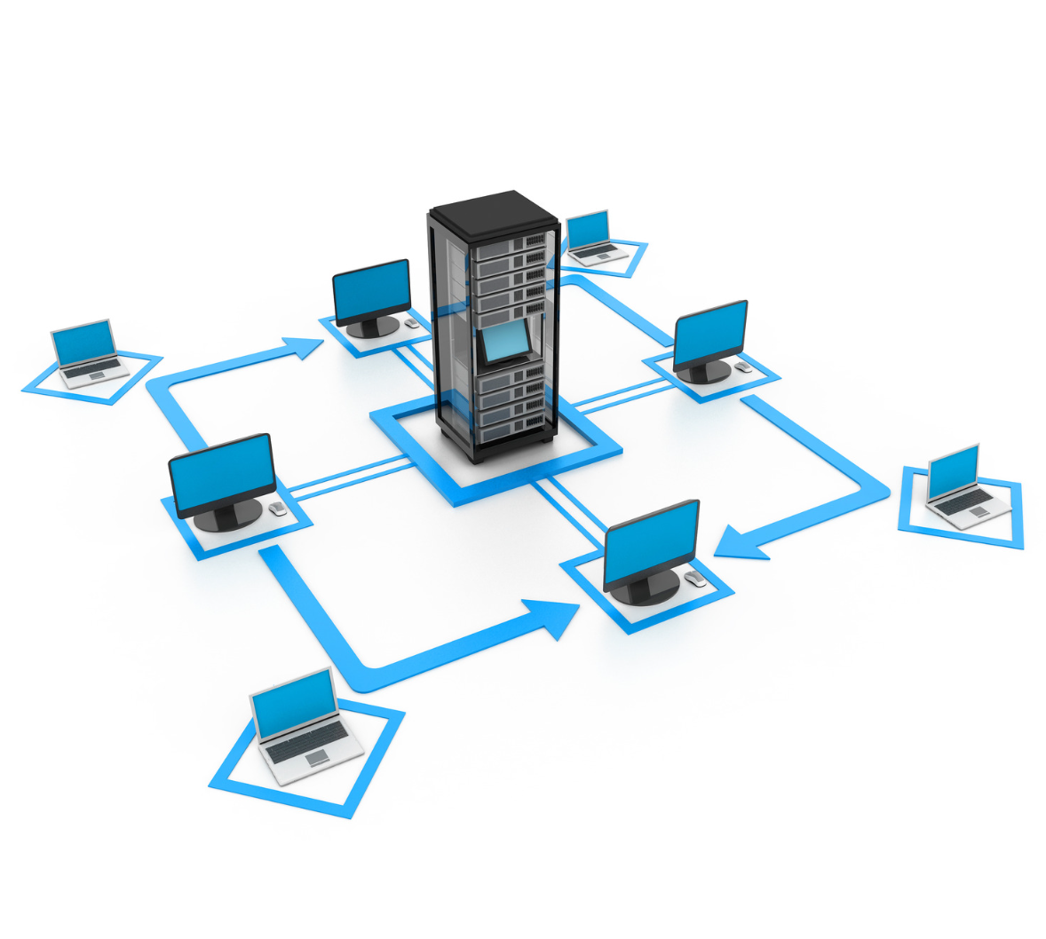
LAN
A local area network (LAN) is a computer network that interconnects computers within a limited area such as a residence, school, laboratory or office building.
Wireless Local Area Network (WLAN): A type of LAN that uses wireless communication technologies like Wi-Fi
Restricted to a building, residence etc
Range 5m to 1 km
Cables, Wifi, cellular
Data rate 2+ mbps
Notes:
A LAN is a communications network that interconnects a variety of devices and provides a means for information exchange among those devices. The scope of the LAN is small, typically a single building or a cluster of buildings. It is usually the case that the LAN is owned by the same organization that owns the attached devices. The internal data rates of LANs are typically much greater than those of WANs.
LANs come in a number of different configurations. The most common are switched LANs and wireless LANs. The most common switched LAN is a switched Ethernet LAN, others are ATM & Fibre Channel LANs. Wireless networks provide advantages in the areas of mobility and ease of installation and configuration.

Slide 25
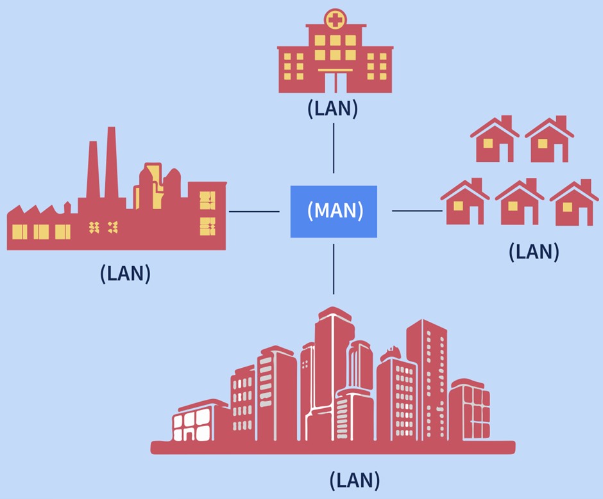
MAN
A metropolitan area network (MAN) interconnects users in a geographic area or region such as which spans an entire city
The primary purpose of a MAN is to interconnect multiple LANs within a defined area.
MANs are commonly used by businesses, educational institutions, and government organizations that have multiple offices within a city.
Range 1km to 50 km
Cables, Wifi, cellular, 3G, 4G
Data rate 2+ mbps

Slide 26

WAN
A Wide Area Network (WAN) spans a large geographical area, connecting multiple LANs or MANs across cities, countries, or even continents.
WANs are designed to facilitate data exchange over long distances, allowing organizations with distributed offices to connect and share information.
WANs connects remote branch offices and facilitate communication between data centers located in different regions.
Cables, cellular, satellite, 3G, 4G
Data rate 2+ mbps
Notes:
Wide area networks generally cover a large geographical area, require the crossing of public right-of-ways, and rely at least in part on circuits provided by a common carrier. Typically, a WAN consists of a number of interconnected switching nodes. Traditionally, WANs have been implemented using one of two technologies: circuit switching and packet switching. More recently, frame relay and ATM networks have assumed major roles.

Slide 27

The Internet
A global system of interconnected computers and computer networks that use standardized communication protocols to exchange information.
It is a network of networks that consists of private, public, academic, business, and government networks of local to global scope, linked by a broad array of electronic, wireless, and optical networking technologies.
The Internet supports a wide range of services and applications, including web browsing, email, file sharing, social media, online gaming, streaming, and more.
Notes:
The Internet evolved from the ARPANET, developed in 1969 by the Advanced Research Projects Agency (ARPA) of the U.S. Department of Defense. It was the first operational packet-switching network. The network was so successful that ARPA applied the same packet-switching technology to tactical radio communication (packet radio) and to satellite communication (SATNET). The need for interworking between these led to Vint Cerf and Bob Kahn of ARPA developing methods and protocols for such internetworking, which led eventually to the development of TCP/IP.

Slide 28
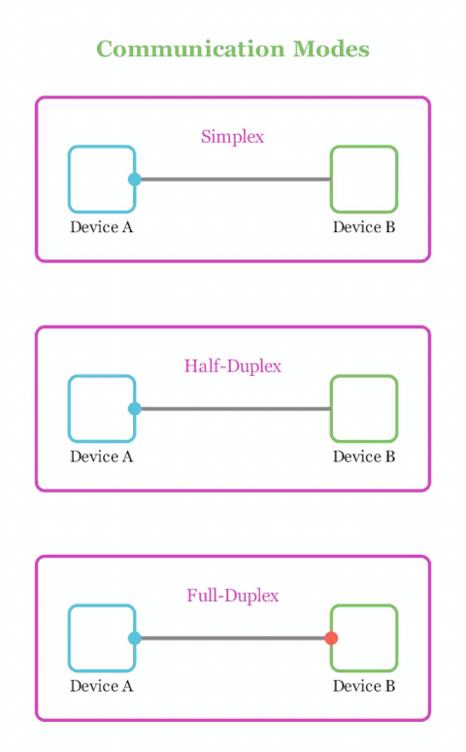
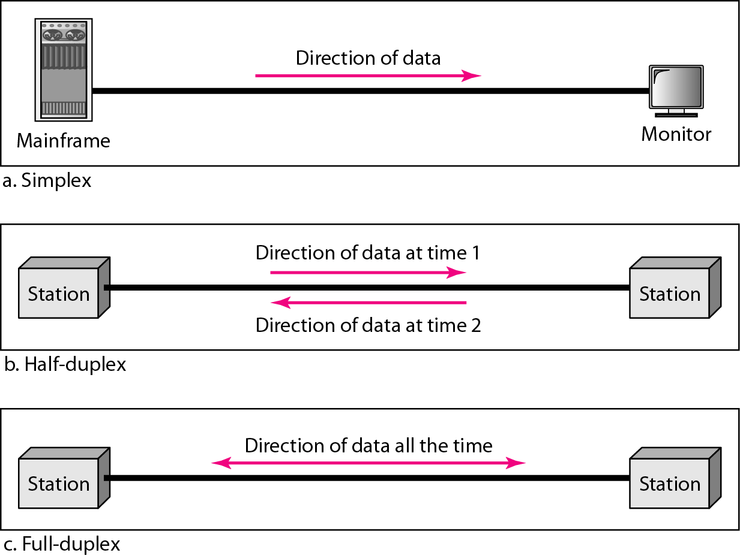
Data Flow in Networks
Notes:
Radio Broadcasting
Television
Loudspeaker
Mouse/Keyboard/joystick to computer
Walkie Talkie
Push to talk
USB 1.0
Telephone

Slide 29
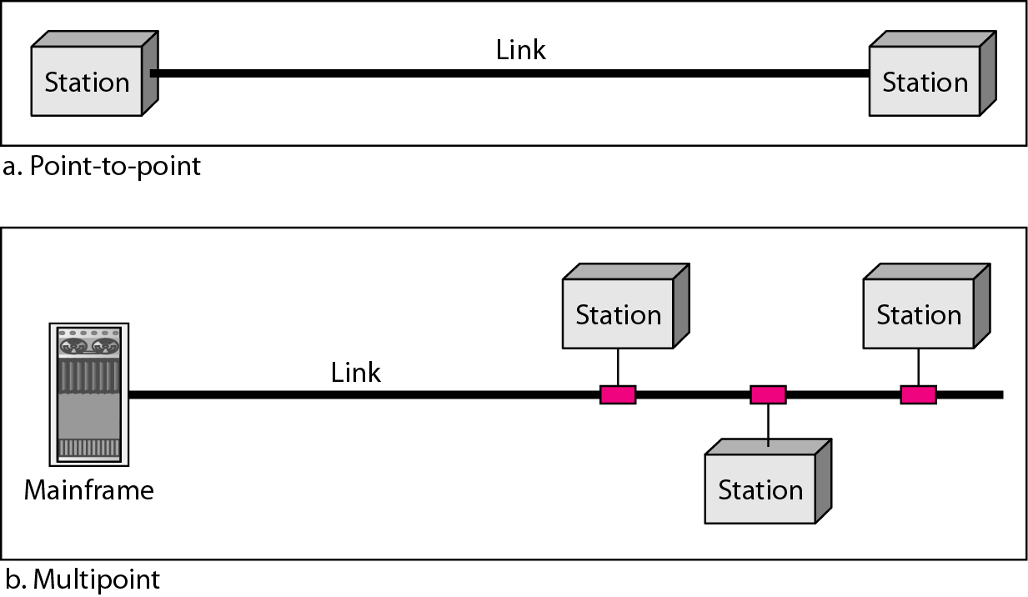
Types of Connections in Networks
Notes:
telephone call
many nodes can receive information transmitted by one node.

Slide 30
Quiz

Slide 31
Quiz
How many basic components make up a simple data communication system?
3
4
5
6

Slide 32
Quiz
Which component of a communication system defines the set of rules governing data transmission?
Sender
Receiver
Protocol
Transmission medium

Slide 33
Quiz
The rate at which data is successfully delivered over a network is known as:
Latency
Throughput
Frequency
Amplitude

Slide 34
Quiz
Which of the following is NOT one of the three primary requirements of network security?
Confidentiality
Integrity
Availability
Scalability

Slide 35
Quiz
What type of network mode allows data to travel in only one direction at all times?
Simplex
Half-duplex
Full-duplex
Multiplex

Slide 36
Quiz
Which communication task is responsible for coordinating the timing between transmitter and receiver so they know when a signal starts and ends?
Interfacing
Synchronization
Flow control
Formatting

Slide 37
Quiz
What is the primary purpose of Flow Control in data communications?
Detecting and correcting bit errors
Preventing the sender from overwhelming the receiver
Encrypting sensitive data payloads
Determining the best path across routers

Slide 38
Quiz
To fully connect N nodes in a fully-connected mesh topology, how many physical links are required?
N
N - 1
N(N - 1) / 2
N²

Slide 39
Quiz
What is the fundamental issue with connecting every node directly to every other node in a large-scale network, leading to the adoption of switched networks?
Inability to send digital signals
Exponential growth of unmanageable physical links and hardware cost
Lack of unicast routing protocols
Incompatibility with packet switching

Slide 40
Quiz
What happens in a half-duplex communication mode?
Signals can flow in both directions simultaneously
Signals can flow in only one fixed direction forever
Signals can flow in both directions, but only one direction at a time
Signals are split equally between sender and receiver bandwidth

Slide 41
Quiz
Why are intermediate data-forwarding nodes (switches/routers) used in modern computer networks?
To increase the length of drop lines
To enable indirect connectivity and share transmission resources efficiently
To force all traffic into simplex mode
To eliminate the need for network protocols

